Slide 1

COURSERA IBM APPLIED DATA SCIENCE CAPSTONE
Opening a New Shopping Mall in Kuala Lumpur, Malaysia
By: Pooja S

Slide 2
BUSINESS PROBLEM
Location of the shopping mall is one of the most important decisions that will determine whether the mall will be a success or a failure
Objective
To analyze and select the best locations in the city of Kuala Lumpur, Malaysia to open a new shopping mall
This project is timely as the city is currently suffering from oversupply of shopping malls
Business question
In the city of Kuala Lumpur, Malaysia, if a property developer is looking to open a new shopping mall, where would you recommend that they open it?

Slide 3
Data
DATA REQUIRED
List of neighbourhoods in Kuala Lumpur
Latitude and longitude coordinates of the neighbourhoods
Venue data, particularly data related to shopping malls
Sources of data
Wikipedia page for neighbourhoods (https://en.wikipedia.org/wiki/Category:Suburbs_in_Kuala_Lumpur)
Geocoder package for latitude and longitude coordinates
Foursquare API for venue data

Slide 4
Methodology
Web scraping Wikipedia page for neighborhoods list
Get latitude and longitude coordinates using Geocoder
Use Foursquare API to get venue data
Group data by neighborhood and taking the mean of the frequency of occurrence of each venue category
Filter venue category by Shopping Mall
Perform clustering on the data by using k-means clustering
Visualize the clusters in a map using Folium

Slide 5
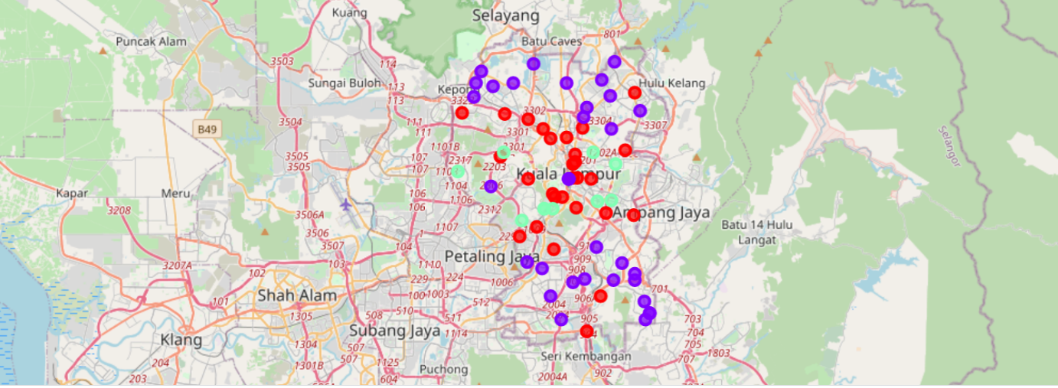
Results
The results from the k-means clustering show that we can categorize the neighbourhoods into 3 clusters based on the frequency of occurrence for “Shopping Mall”:
Cluster 0: Neighbourhoods with moderate number of shopping malls
Cluster 1: Neighbourhoods has no existence of shopping malls
Cluster 2: Neighbourhoods with high concentration of shopping malls The results of the clustering are visualized in the map below with cluster 0 in red colour, cluster 1 in red colour, and cluster 2 in purple colour.

Slide 6
Discussion
Most of the shopping malls are concentrated in the central area of the city
Highest number in cluster 2 and moderate number in cluster 0
Cluster 1 has very low number to no shopping mall in the neighborhoods
Oversupply of shopping malls mostly happened in the central area of the city, with the suburb area still have very few shopping malls

Slide 7
Recommendations
Open new shopping malls in neighborhoods in cluster 1 with little to no competition
Can also open in neighborhoods in cluster 0 with moderate competition if have unique selling propositions to stand out from the competition
Avoid neighborhoods in cluster 2, already high concentration of shopping malls and intense competition

Slide 8
Conclusion
The neighbourhoods in cluster 1 are the most preferred locations to open a new shopping mall. The findings of this project will help the relevant stakeholders to capitalize on the opportunities on high potential locations while avoiding overcrowded areas in their decisions to open a new shopping mall.

